Slide 1

Government Engineering College, Modasa
Department of Information Technology
HOPE (Helping Oppressed People Everywhere)
Project Members:
Dhruvin Prajapati – 180163116018
Hiren Jadvani – 180163116008
Parth Vora – 180163116033
Mohit Dholariya – 180163116005
- Guided by Prof. jwalant B. Baria (CE)

Slide 2
Todays Outline
Introduction
Objectives
Tools & Technology
Advantages & Drawbacks
Methodology
System Diagrams
Database
Implementation

Slide 3
Introduction
1

Slide 4
This project is design for social working, In this project we provide interface between kind people and orphan children as well as old age home.
This project work like a NGO(Non Government Organization) which provides the helpful work for society.
In this project we are going to add more features like Donation for helping organization like orphanage and old age home, missing and found person reports .
Our NGO provide life living things like food, cloths for poor people.

Slide 5
Objectives
2

Slide 6
To Helping orphan and old age home people.
To Provide training/education centre and health centre.
To fight against exploitation, injustice and corruption if found against any individual, class, community in the society.
To work for uplifting the status of woman in the society.
To provide scholarships/ financial help to poor rural/village people for their overall development.
To provide help to people suffering from natural calamities such as flood, Earthquakes, motor accidents, etc.

Slide 7
Tools & Technology
3

Slide 8
Front End: Back End:
- Php -MySQL
-HTML
-CSS
-JavaScript
-bootstrap3

Slide 9
For User,
Requirements
Pentium 4+ Processor
256GB+ ROM
2GB+ RAM
Windows 7+ OS

Slide 10
Advantages & Drawbacks
4

Slide 11
Advantages:
No paperwork
Reliable
Easy to use
Transparent System
Portable
Drawbacks:
Devices must needed
Mandatory Internet connection

Slide 12
Methodology
5

Slide 13
There are 3 mainly modules in our project.
1. Administrator
2. Visitor / Donator
3. Receiver / Organization

Slide 14
System Diagrams
6

Slide 15
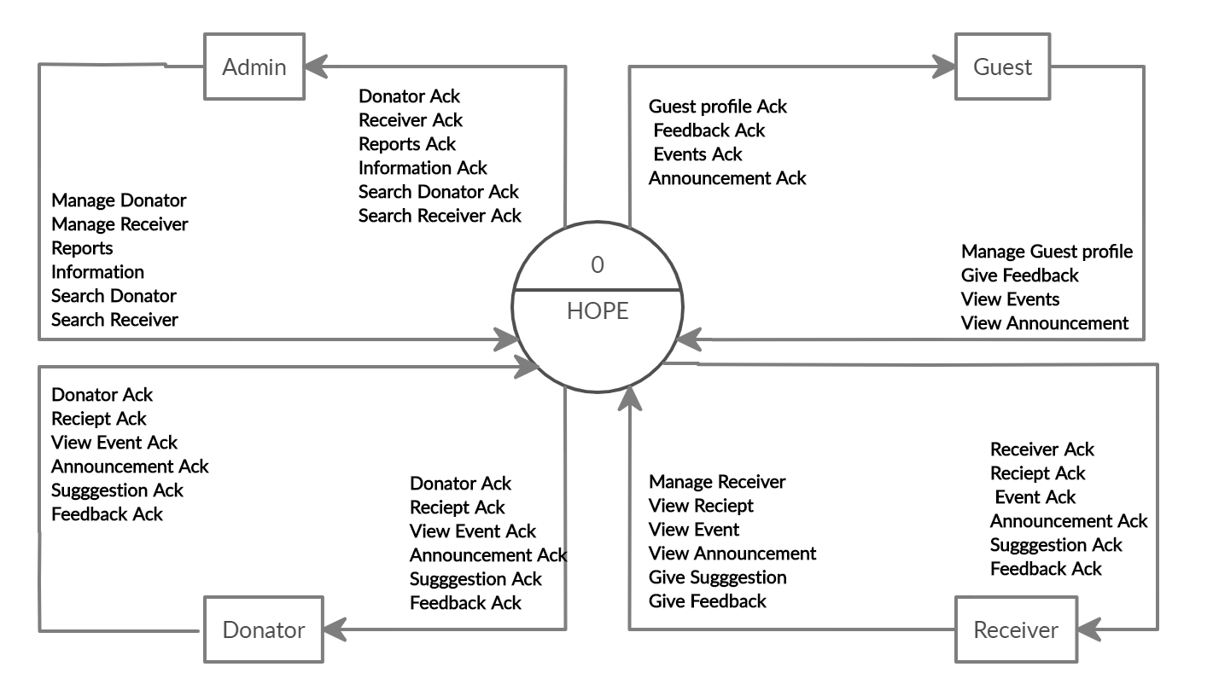
Fig.1 Zero level DFD

Slide 16
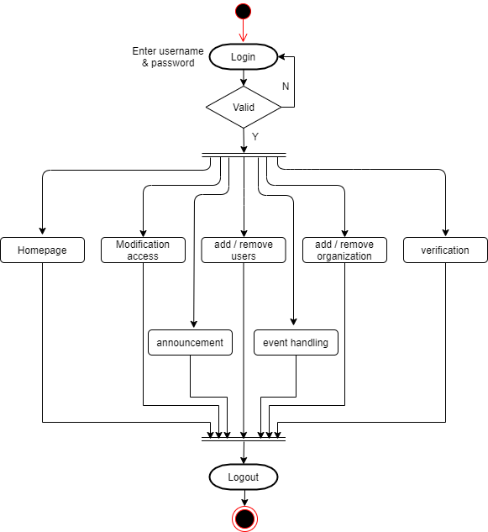
Fig.2 Admin Activity

Slide 17
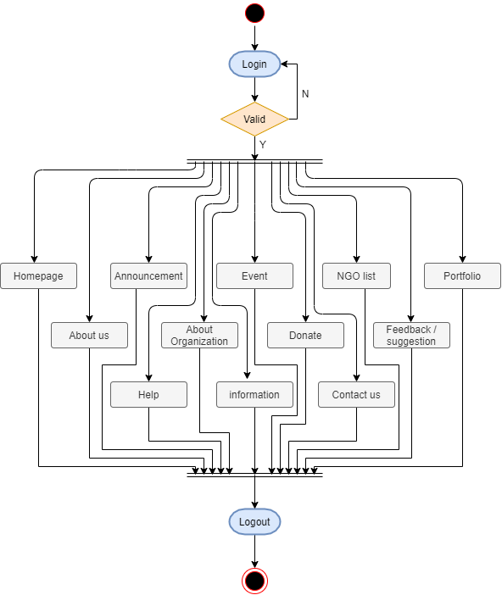
Fig.3 Donator / Viewers Activity

Slide 18
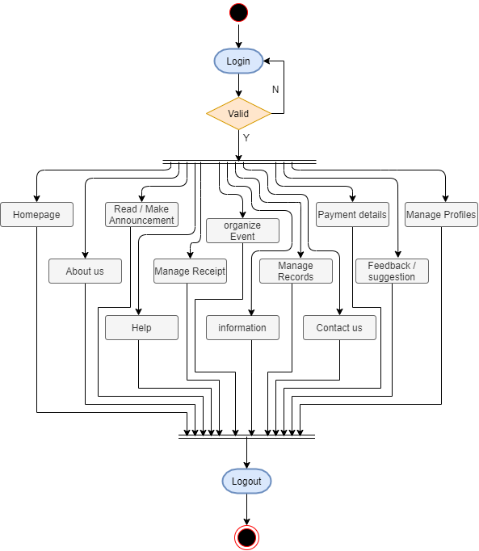
Fig.4 Receiver / Organization Activity

Slide 19
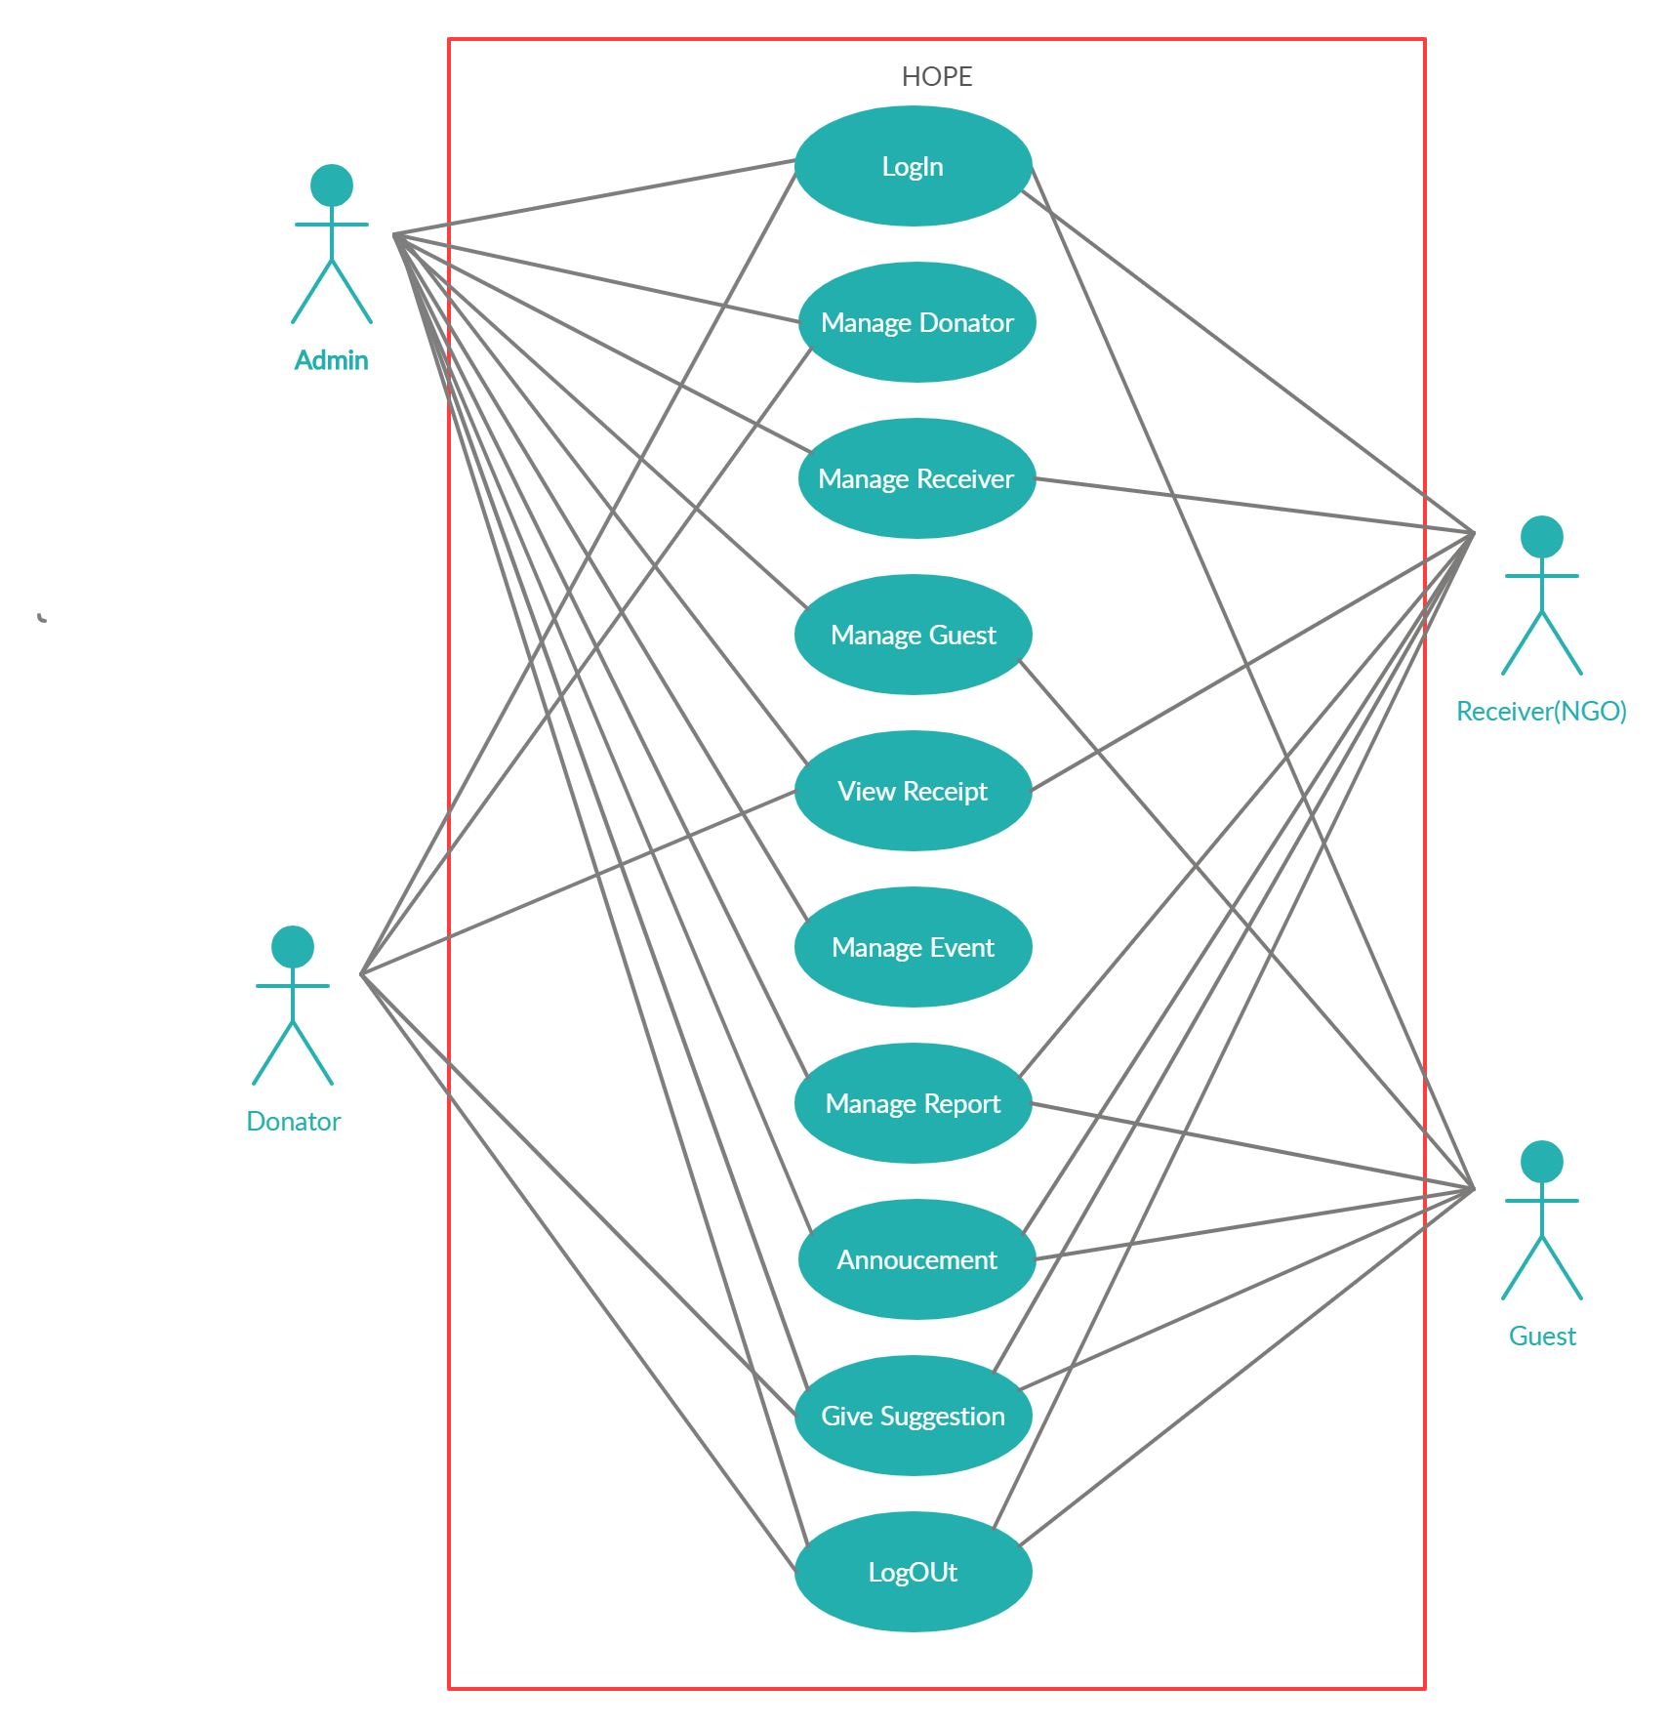
Fig.5 System Use case

Slide 20
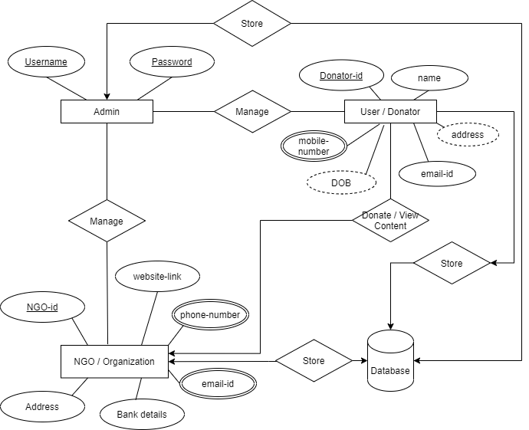
Fig. ER Diagram

Slide 21
Database
7

Slide 22
Field Name | Data Type | Size | Constraint | Description
First Name | Varchar | 15 | Not Null | Store User Name
Last Name | Varchar2 | 15 | Not Null | Store User Name
Mobile No. | Numeric | 10 | PK | Store User Mobile No.
Email id | Varchar2 | 50 | Unique key | Store Email id
Password | Varchar2 | 20 | Not Null | Store Password
Confirm Password | Varchar2 | 20 | Not Null | Store Confirm Pass.
DOB | Date | - | Not Null | Store date of Birth
Address | Varchar2 | 100 | Not Null | Store Address
Photo | Varchar2 | 500 | Not Null | Store Photo’s Path
Fig.7 Registration table

Slide 23
Field Name | Data Type | Size | Constraint | Description
Username | Varchar2 | 10 | PK | Store Admin ID
Password | Varchar2 | 8 | Not Null | Store Password
Fig.8 Admin table

Slide 24
Implementation
8

Slide 25

9. Logo

Slide 26
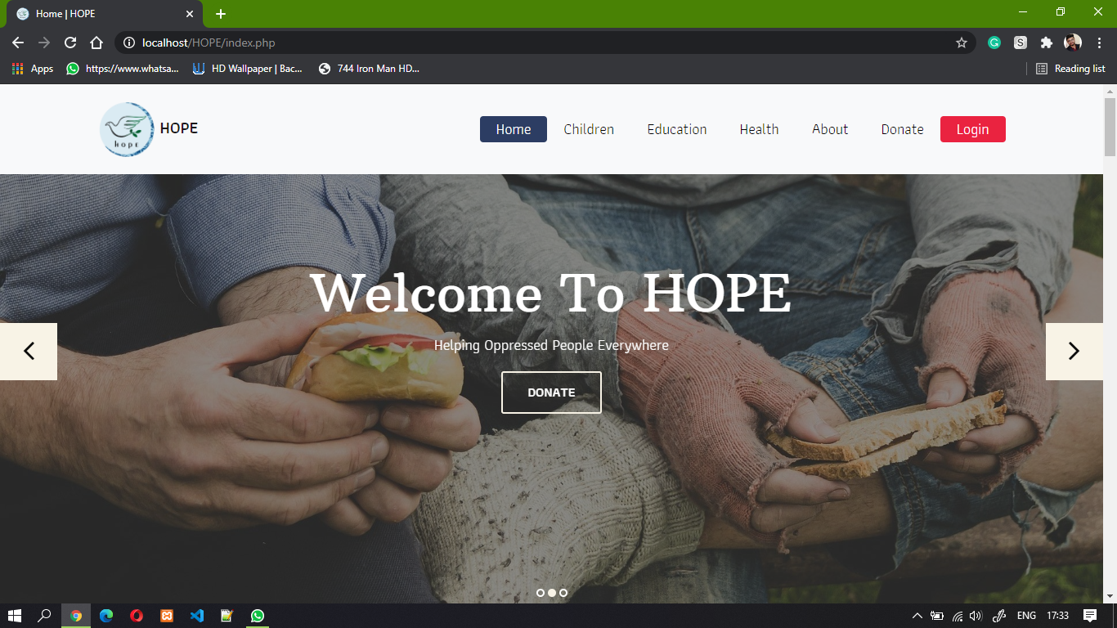
10. Homepage

Slide 27
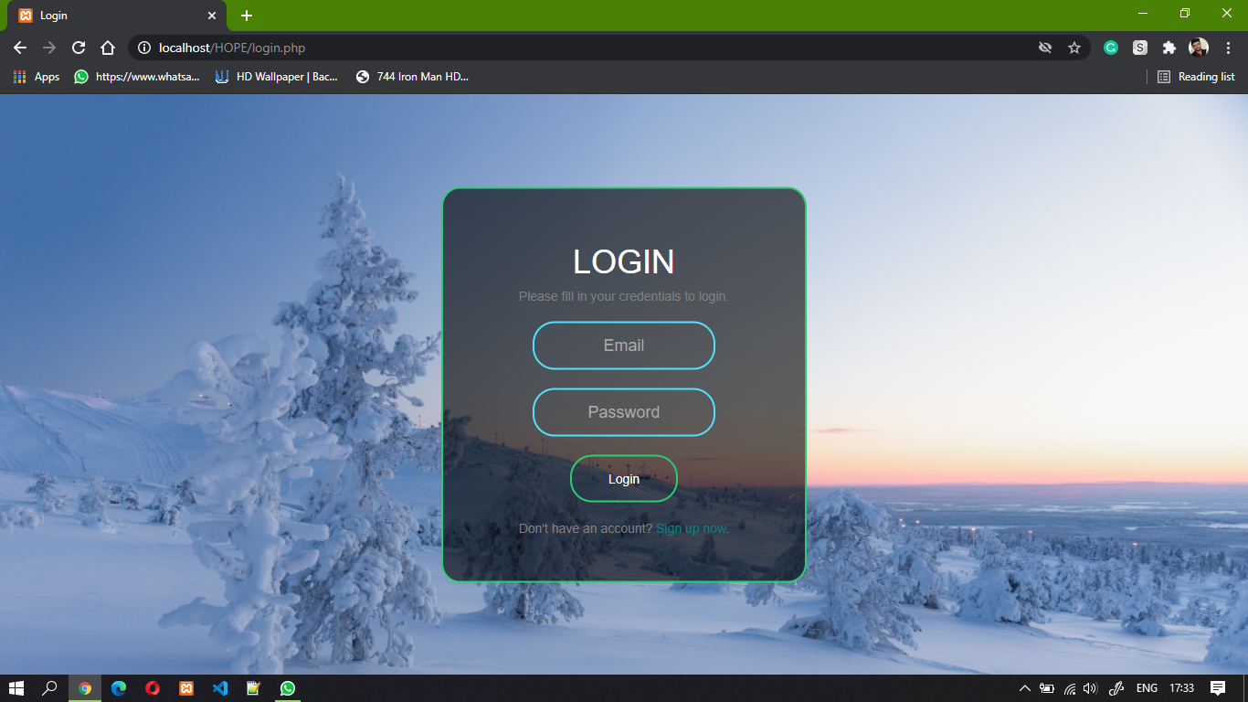
11. Login

Slide 28
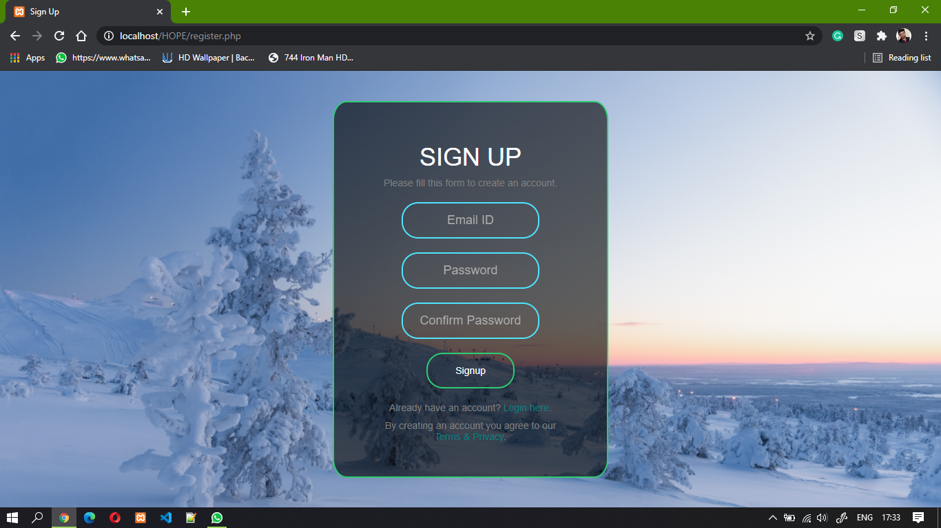
12. Signup

Slide 29
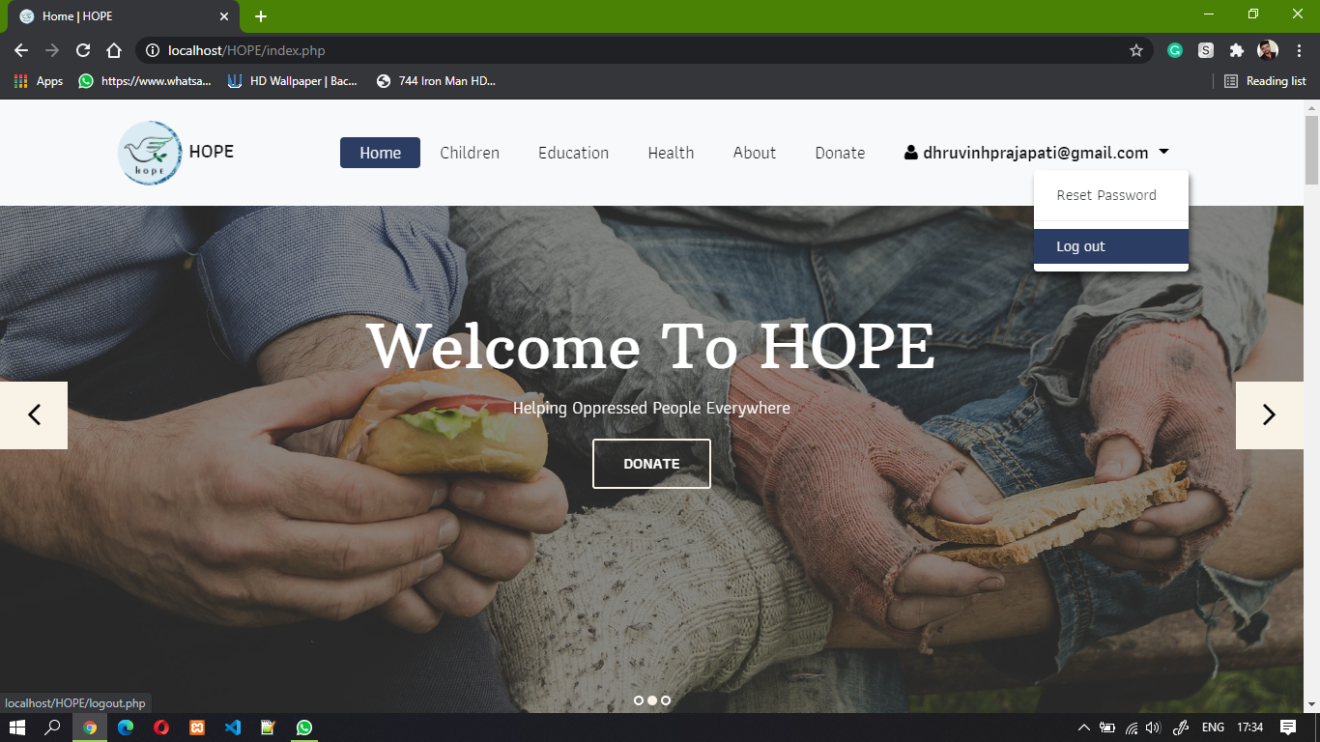

Slide 30
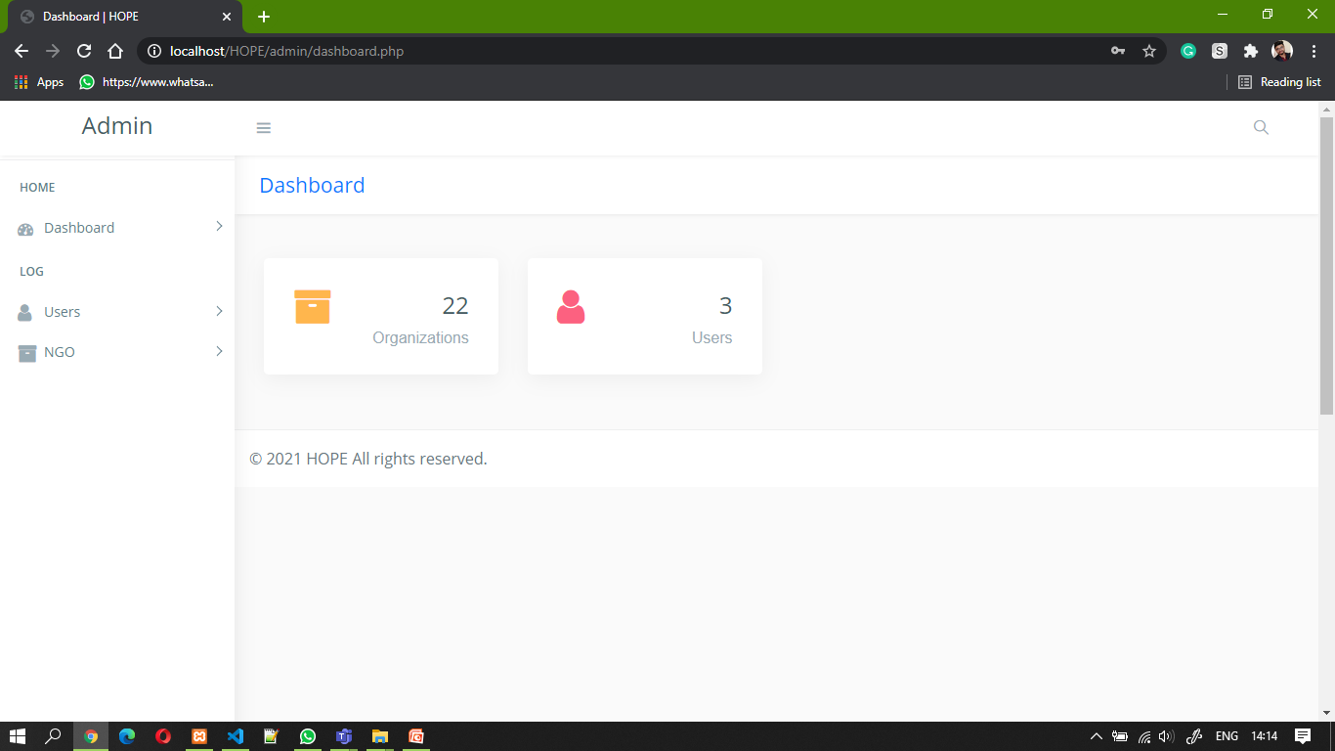
14. Admin panel

Slide 31
Thanks!
Any questions?

